Slide 1
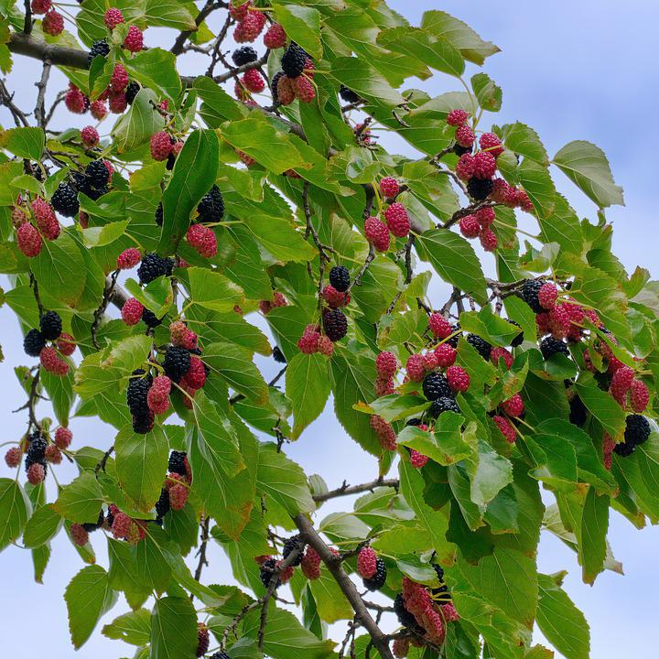
Urban Agroforestry
Notes:
This presentation is meant to be a brief high level overview. Most of you with interest in this topic will notice a lot of information that is not covered. I’m going to do my best to present primarily on the areas that I think are of interest to the urban forester.

Slide 2
Contents of this presentation
Who I am.
What is Agroforestry?
Opportunities in Urban Environments
Developing a Planting Plan
Fostering Support
Additional Resources

Slide 3
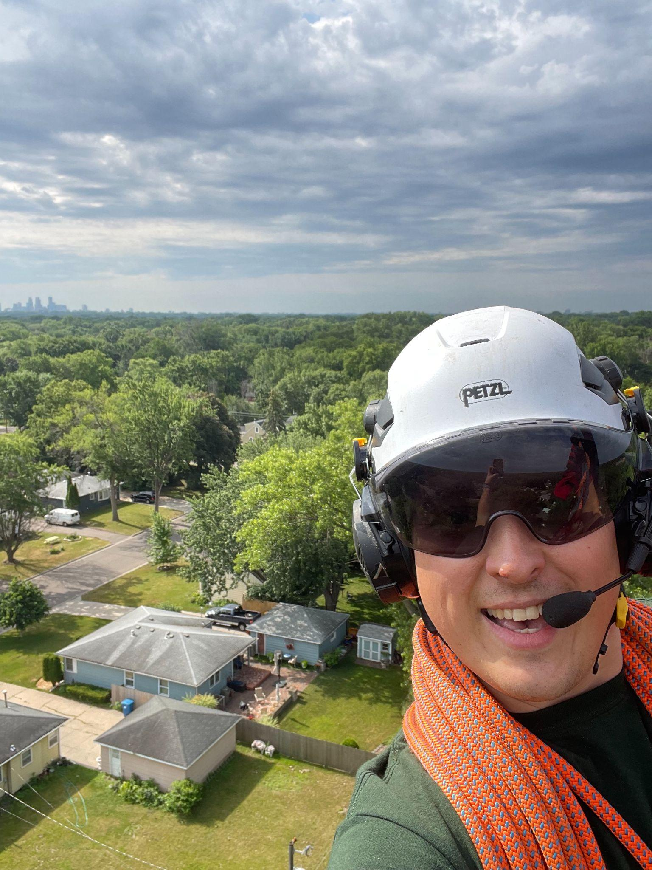
Lars Lidahl
Former Food System Specialist for PIIC
Trainee Arborist for Bratt Tree Company
General systemic sustainability nerd

Slide 4
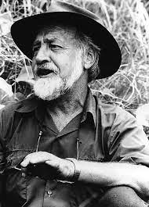
“Though the problems of the world are increasingly complex,
the solutions remain embarrassingly simple.”
—Bill Mollison
Notes:
Bill Mollison, as some of you may recognize is one of the original permaculturalists. While I think there are some areas in which modern permies may be lacking, some of the founding ideology provides a useful framework for making long term sustainable decisions.

Slide 5
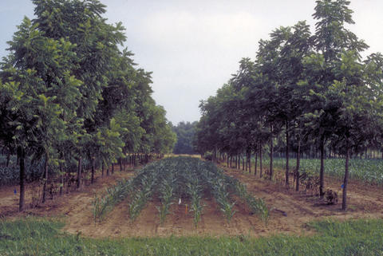
01
What is Agroforestry?
Notes:
This is a broad term, the practice is not yet fully defined or explored. I like the USDA definition, and while urban agroforestry may not meet the scale of production that a more traditional farm setting would, I think there is a lot of room in this definition to cover the practices that can be implemented within our cities. I’m going to avoid going into the various accepted practices, given that I don’t think they are particularly applicable here, you can find links to them in the resources slide at the end of this presentation.

Slide 6
USDA Definition
Agroforestry is the intentional integration of trees and shrubs into crop and animal farming systems to create environmental, economic, and social benefits.
Notes:
So this doesn’t look like it fits with the urban environment at first glance. Take a closer look and expand your ideas of what crop and animal farming systems look like. Think backyard chickens, community gardens, and local parks. As we continue to develop our ways of thinking around community spaces to promote equity, inclusion, and sustainable practices, room opens up for this to become a standard practice in urban greenspaces.

Slide 7
The Four I’s
For a management practice to be called agroforestry, it typically must satisfy the four "i"s:
Intentional
Intensive
Integrated
Interactive
Thinking about the ways in which your project meets these criteria is a great framework to use.
Notes:
Analyzing with these four categories helps to clarify what may constitute an agroforestry practice. Take the case of a backyard with a few chickens. You can intentionally plant hazelnuts as an understory crop, with a dwarf cherry as part of your canopy, both of which function to provide shade for a set of young sugar maples that will eventually grow to cover the cherry and hazelnuts. In the area of the dripline of the maples you now have 3 different plant crops, shelter and forage for your chickens, and free fertilization of your trees taking place. You’ve intentionally structured your planting, you have an intensive system of crops to harvest at different times, the crops all rely on one another thus they are integrated, and the chickens function to interact with the entire system both by foraging and fertilizing.

Slide 8
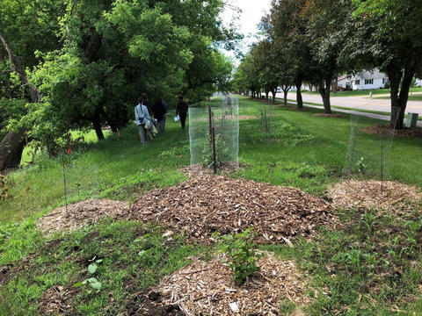
02
Opportunities in Urban Environments
Notes:
This is mostly my personal opinion of where we should be looking for areas to take on urban agroforestry projects. It is by no means comprehensive, and I’m sure you all will find many other places of interest to work on. The next couple of slides are some statistics to give you an idea of the scale of our urban forests and how much opportunity lays waiting in them.

Slide 9
5,500,000,000
127,000,000
44,000,000
Trees in US cities
Acres of leaf area
Tons of dry leaf weight biomass
Notes:
Cities of all sizes have active urban forests, these are just some basic estimates of the overall tree population and density of those forests.

Slide 10
18,300,000,000
Economic value of services provided by Urban Forests, annually.
Notes:
Annually, these trees produce a total of $18.3 billion in value related to air pollution removal ($5.4 billion), reduced building energy use ($5.4 billion), carbon sequestration ($4.8 billion) and avoided pollutant emissions ($2.7 billion). States with greatest annual urban forest values were: Florida ($1.9 billion), California ($1.4 billion), Pennsylvania ($1.1 billion), New York ($1.0 billion) and Ohio ($971 million).

Slide 11
Where should I look for opportunities?
Tree removals
Boulevard developments
Community Gardens
Park and greenspace renewals
Front yards
Back yards
Apartment Green Spaces
Notes:
To me these are the most pressing areas to look at for a new planting project. They represent a wide swath of green spaces within the urban environment, and offer a diverse array of interesting potential for developing a food forest.

Slide 12
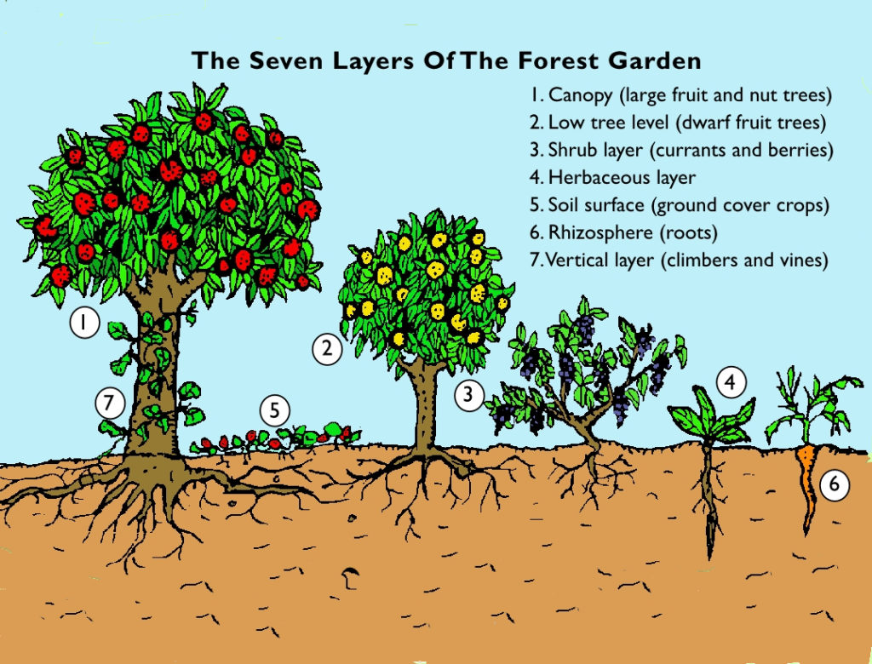
03
Developing a Planting Plan
Notes:
The trickiest bit of the whole bunch, within this you will be making decisions where the full impact will not be seen for a decade or more, plan carefully, research thoughtfully, and act intentionally.

Slide 13
Considerations for Planting Plans
Need and Desire
Space
Capacity
What need would an agroforestry planting fill? What sort of foods do you like that are hard to find or expensive?
What volume of space are you planting? What amount of that space will a mature variety occupy? Will your species become a hazard or nuisance to neighbors?
How much labor can you invest into the forest annually? Will your species need intensive pruning to maintain production?

Slide 14
Species Selection
There are A LOT of wonderful trees and edible perennials that will thrive here.
Use the four i’s (Intentional, Intensive, Integrated, Interactive)
Consider your needs, space, and capacity.
Take it slowly, you’re planning across generations.

Slide 15
A couple of species you can use…
Apricot
Blackberry
Blueberry
Buffaloberry
Cherries
Chestnuts
Chokecherry
Cranberry
Currant
Elderberry
Gooseberry
Hardy Kiwifruit
Hazelnut
Hickory
Honeyberry
Jostaberry
Juneberry
Korean Pine
Lingonberry
Nannyberry
Paw-Paw
Peaches
Pear
Plum
Walnut

Slide 16
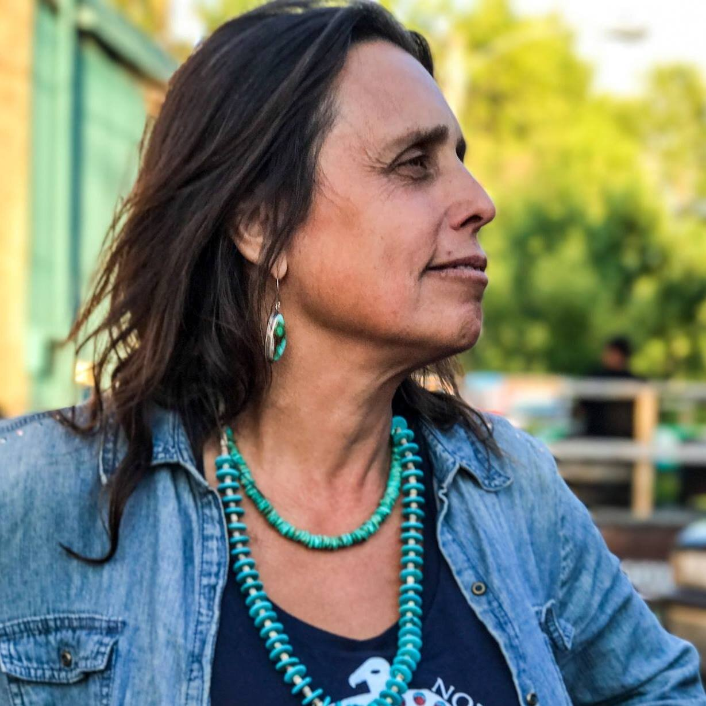
“Let us be the ancestors our descendents will thank.”
—Winona La Duke

Slide 17
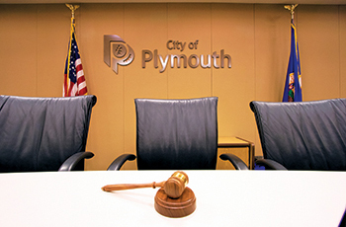
04
Fostering Support
Notes:
This is where you’ll need to advocate for your projects. Convincing people that this work is worthwhile and beneficial is a huge part of the battle. You may face zoning issues, HOA restrictions, and unconvinced neighbors. Exercise some tact, become a known entity, and argue for planting in the name of public good.

Slide 18
Get to know your local leaders
City Council
Park Board
HOA’s
Often motivated by wanting to see a vibrant and verdant community. Encourage them to adopt ordinances allowing for agroforestry plantings.
Oversee the planning and development of local parks. If you don’t own space, get to know these folks and advocate for a project at a park near you.
Often despised, easily influenced. Band together with your neighbors and advocate for apples over ashes.
Notes:
Becoming a known entity to all of these folks is helpful, an engaged community member is a voter, an advocate, and a valuable ally. Failing all of that, you can be a real squeaky wheel instead. Try the honey approach, you may just find yourself with some serious organizational backing to do some really cool work.

Slide 19
Focus on three main points
Aesthetic
Environmental
Agricultural
Cherry and apple blossoms are beautiful. Many fruiting varieties look great throughout the year and can easily function as landscape plants
Trees are one of the best carbon sinks we can readily employ. Additionally they help save energy by shading large portions of the city.
Food deserts are real, and urban environments are rife with them. Why not plant something that can help stock your local food bank?

Slide 20
Avoid duplicating efforts
Use existing resources where you can find them
City Tree Sales
Master Gardeners
University of Minnesota Extension
Minnesota Department of Agriculture
Certified Arborists
There is likely already a dedicated group of passionate people that would love to help you! Use those resources to their fullest extent.

Slide 21
Resources
In depth information used in creating this presentation.
Links
USDA Agroforestry
Forest Gardening
Urban Forest Statistics
UFOR Nursery and Lab
UMN Agroforestry
Plymouth PRAC
Community Food Forest
Plymouth Tree Sale

Slide 22
City of Plymouth Annual Tree Sale
Tree Sale timeline:
February 21, 2023 - On-line preview available @ www.plymouthmn.gov/treesale
March 1, 2023 - Ordering begins (NOTE: Some species sell out very quickly!)
May 12, 2023 3-6pm - Pick up
May 13, 2023 8am-Noon - Pick up
We don’t have confirmation of species & quantities from the supplier yet.
Due to continued high demand, we’ll offer 20% more plants this year:
300 Deciduous trees
240 Coniferous trees
780 Shrubs
280 Fruit
Lawns to Legumes: https://bluethumb.org/lawns-to-legumes/apply/ -- Minnesota residents are eligible to apply for Lawns to Legumes cost-share funding of up to $350 to create pollinator habitat in their yards - and a rain garden would be considered a pollinator habitat.

Slide 23
Thanks!
Do you have any questions?
larry.lidahl@gmail.com
651-888-0145
bratttree.com

Slide 24
Fonts & colors used
This presentation has been made using the following fonts:
Montserrat
(https://fonts.google.com/specimen/Montserrat)
Playfair Display
(https://fonts.google.com/specimen/Playfair+Display)
#a6bf5a
#c9d8c8
#000000
#ffffff

