Slide 1

Welcome to Republic Services
Sustainability In Action
A Leader in Environmental Services and we are Dedicated to Creating a Cleaner, Safer, Healthier World for All

Slide 2

Statewide Recycling Statistics
MN 2030 Goal: 75%
MN Traditional Recycling Rate 28.9% (2021)
MN Organic Recycling Rate 16.6% (2021)
MN Combined 45.5% / US Combined 33%

Slide 3
How does recycling work in Plymouth?
Republic is contracted to provide recycling collection to 25,800 residential dwellings
Every-other week collection of recycling
Weekly collection of organics for 3,700 homes (14+%) that have elected to participate.
5359 tons of recycling in 2023
Notes:
Average of 446 tons per month of recycling
Organics will average around 7 lbs per home per week. It is a fast growing program, more to come on that.

Slide 4
Keys To A Successful Program
Residents/Businesses
Sourcing Clean and Dry Acceptable Recyclables which meet our End Markets Quality Specs.
Desirable
End Market Customers
Marketable
Having Numerous Sustainable End Markets For Said Commodity that Have a Financial Value.
Recycling Facility
Materials that Generate Large Amounts of Volume that Can Be Identified, Captured and Sorted by the Technology in our Facility.
Capturable

Slide 5
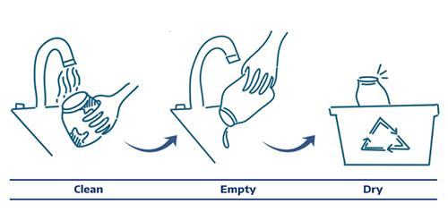
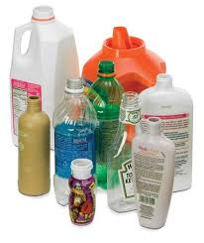
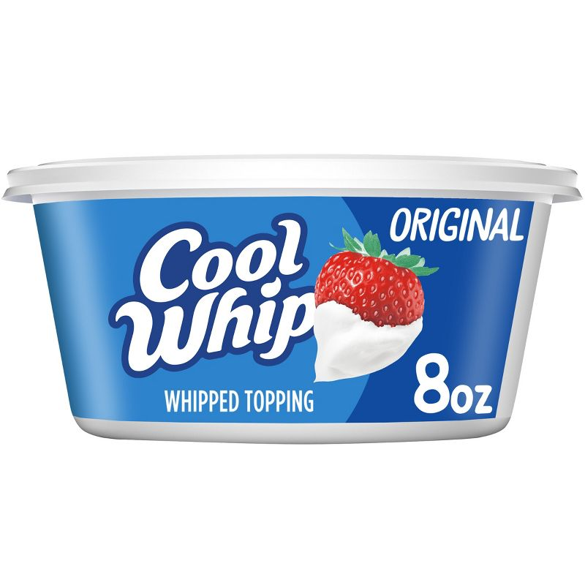
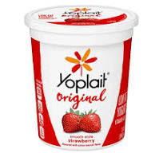
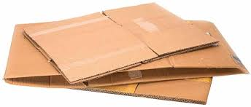
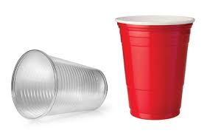


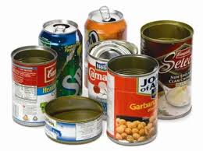
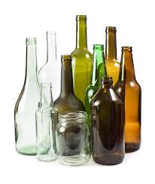

2024 Recycling Guide
Please do not bag your recyclables! Place each item in the cart individually!
We Recycle!
Please make sure your recyclables are empty, clean and dry before placing in your recycling cart.
⮾ Not acceptable at curbside since they…....
Damage or Entangle Equipment | Are Not Recyclable
◦ Stretch Film | ◦ Foil pouches, bags, wrappers
◦ Plastic bags | ◦ Dishes, vases, mirrors
◦ Ropes, hoses, chains, X-Mas Lights | ◦ Plastic straws and utensils
◦ Scrap metal | ◦ Glitter or wrapping paper
◦ Bulk items | ◦ Polystyrene foam
◦ Shredded paper | ◦Electronics
Harm Workers | ◦Diapers
◦ Batteries | ◦Plastic Toys
◦Medical Sharps | ◦Yard Waste
◦ Propane tanks (all sizes) | ◦Food Waste
◦Hazardous products | ◦Wood / Pallets
Plastic Bottles &Jugs
Plastic Cups & Containers
Boxes (Flattened)
Water, soda and juice bottles, shampoo bottles and detergent jugs. (Caps On)
Yogurt cups, pudding and fruit cups, clear disposable cups (no straws), margarine/ whipped cream tubs, cottage cheese and similar containers. (Lids On)
Cardboard, cereal, cracker, pasta and tissue boxes, shoe, toothpaste and other toiletry boxes.
Cartons
Paper
Metal
Glass
Milk Cartons, juice cartons, juice boxes, soup, broth and wine cartons (Caps On)
Mail, office and school papers, magazines, catalogs newspapers, inserts, and phone books. No Shredded Paper
Food cans and beverage cans (Labels Ok)
Brown, green and clear bottles, jars (No Lids)
Twin Cities Customer Service:
763-972-3335
RepublicServices.com
Notes:
Check out the City website and/or Hennepin County

Slide 6
2.Capturable
How the Material is Captured

Slide 7
How is material captured in Plymouth?
MRF Tour Video
https://www.youtube.com/watch?v=6Bwlii0m39M

Slide 8
3. Desirable
Desirable vs. Undesirable

Slide 9
Wish Recycling
Putting non-recyclable items in the recycling bin with hope they will be recycled
  Does more harm than good
Anything smaller than a credit card do NOT bother throwing in the bin
Keep caps on bottles
WHEN IN DOUBT THROW IT OUT
Notes:
Stringers wreck equipment
Batteries burn facilities to the ground

Slide 10
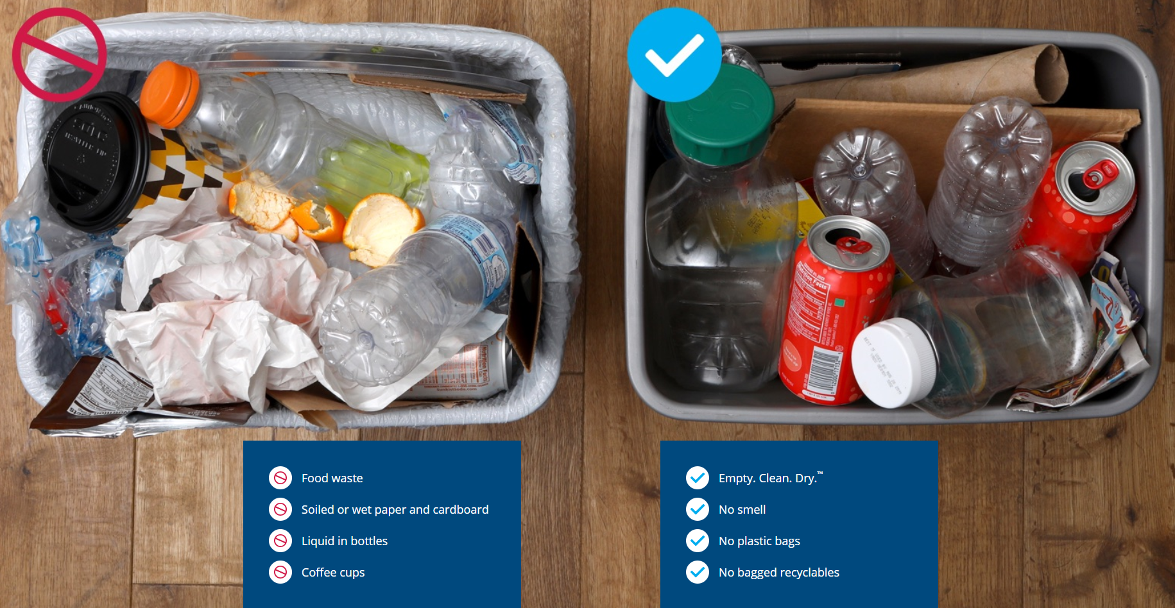

Slide 11
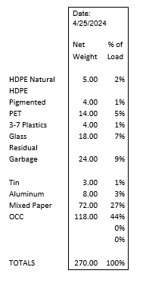
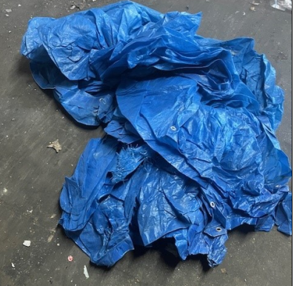
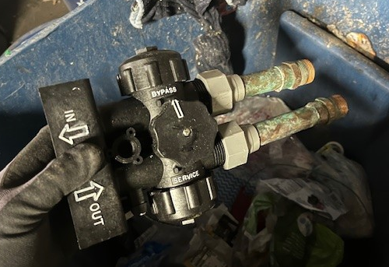
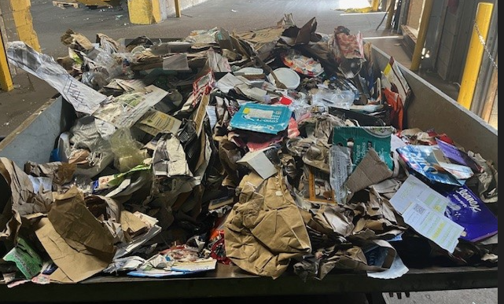
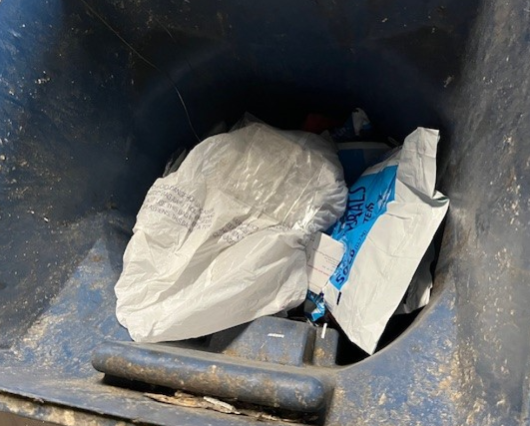
Plymouth Recycling Sort Results

Slide 12
4. Marketable
Where Does it Go?
Notes:
Ultimately everything (85%) needs to get to a market

Slide 13
Products Made From Recyclables

Slide 14
Local End Markets
Local Commodity End Markets | Local Market | Recycled Into
#2 HDPE | Bedford Worthington, MN Avon Paynesville, MN | Plastic Lumber, Freshwater and Saltwater Pilings, Boardwalk in New Jersey Garage and Patio Floor Tiles and Lawn Edging which is sold through Menards
Cardboard | LDI Becker, MN | Brown (Kraft) paper
Cardboard and Mixed Paper | West Rock St. Paul, MN | Liner Board
Glass | Strategic St. Paul, MN | Glass Bottles and Food Containers
Steel Cans | AMG St. Paul, MN | Turned into steel much of which was used on the new 35W bridge after the collapse

Slide 15
What’s the next innovation?
Polymer Center Video https://www.youtube.com/watch?v=qPlgCrK8gZs

Slide 16
Thank you!
Any questions?
Steve Schiefelbein
612-819-9736
sschiefelbein@republicservices.com.com
questions?

